Slide 1
Pre-pregnancy care
Dr. Rasika Herath
Department of Obstetrics and Gynaecology

Slide 2

Objectives
To know the aims of counselling
Pre-pregnancy assessment of a woman
General pre-conceptional advices
Advices regarding medications
Advices related to maternal age, BMI, general life style modifications
Place of genetic counselling
Specific medical diseases

Slide 3
Healthy woman
Healthy pregnancy
Best possible outcome
Happy mother and baby
Healthy offspring

Slide 4
Pre-conceptional care
Healthy woman
Healthy pregnancy
Best possible outcome
Happy mother and baby
Healthy offspring
Optimum pre-pregnancy conditions
Well controlled medical conditions
Optimum control of complications/ medical conditions during pregnancy
Near normal outcome of pregnancy

Slide 5
Aims of pre-pregnancy care
To inform the couple about general health advices
Detect any risk factors for pregnancy
Identify medical diseases which needs optimizing
To discuss the impact of medical disease on pregnancy
To discuss the impact of pregnancy on medical disease
To identify the couples who are at risk of developing genetically abnormal babies
To discuss about the health care facilities available to the couple
To discuss contraception if pregnancy to be differed

Slide 6
When and whom to counsel ?
3-6 months before conceiving
Prior to assisted reproductive techniques
Every woman planning to conceive would benefit from general advises.
Special attention to women with risk factors
(medical and mental conditions, age related, BMI related..

Slide 7
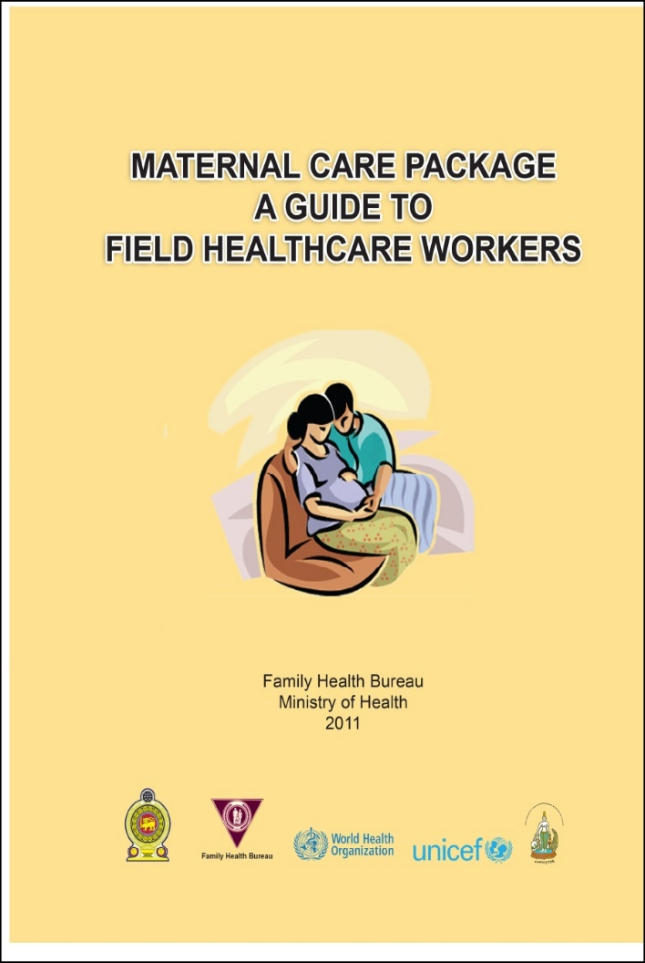
Pre-pregnancy care plan in Sri Lanka
All eligible couples should be registered in the eligible couple register (H 526) by the area PHM.
All the women who are getting pregnant are assumed to have pre-pregnancy care
Rubella immunization,
preconception folic acid supplementation,
screening for medical condition
nutritional assessment
If required necessary family planning services
They should be educated when to and how to inform PHM once they get pregnant.
These services should be provided through women’s health program and family planning program.

Slide 8
Initial assessment of the patient
Review past medical history
Identify potential problems
Assess the control of chronic disease
Review medications
Review family history
Identify the potential familial diseases
(e.g. Thrombophilia, genetic conditions and diabetics)
Genetic disorders
Specialist genetic counselling

Slide 9
Initial assessment of the patient
Review obstetric history
previous pregnancy complications :
pre-eclampsia, preterm delivery, GDM
any labour complications
Check smear history
Ensure abnormal cytology appropriately treated
Reduce risk of viral disease
Has the woman being vaccinated for Rubella?
(HIV status normally checked antenatal)

Slide 10
Initial assessment of the patient
Clinical examination for general health
BMI
Cardio vascular /BP /Murmurs
Respiratory

Slide 11
General pre-conceptional advice
Diet
Encourage to eat fruit / vegetables / proteins / fiber; whole grain rice/ diary products
These will assist in increasing the stores of vitamins, iron and calcium.
Vegetarians are at risk of nutritional deficiencies and may need supplements
Women having high intake of caffeine should be advised to cut down ( maximum of 4 cups of coffee, 8 cups of tea/ 8 cans of Coca-Cola a day)
High caffeine intake is associated with IUGR

Slide 12
General pre-conceptional advice
Food to avoid
Food to avoid
Food | Risk of containing | Fetal complication
Unpasteurized milk | Listeria | Miscarriage
Uncooked or under‐ cooked Raw shellfish (e.g. oysters) | Listeria | Miscarriage
Uncooked or cured meat | Toxoplasma | Fetal CNS defects
Liver and liver products | Excess vitamin A | Cranial– neural crest tissue defects

Slide 13
General pre-conceptional advice
Supplementation
0.4 mg of folic acid to every woman planning pregnancy and continued till 12 weeks of pregnancy
Reduce the risk of neural tube defect
Higher dose of FA ( 5.0 mg) per day is indicated in women
with a previous pregnancy affected by an NTD
who themselves are affected with an NTD;
with a sibling or parent affected with an NTD;
taking antifolate drugs (e.g. most antiepileptic agents, sulfasalazine)
with diabetes
with a raised BMI (>35 kg/m² )
with thalassaemia trait throughout pregnancy
with thalassaemia or sickle cell disease throughout pregnancy.

Slide 14
General pre-conceptional advice
Smoking:
Advise to stop smoking for fetal and her own health
If smoking is stopped 10% reduction in fetal & infant deaths

Slide 15
Smoking
Maternal risks
Fetal risks
Miscarriages
Preterm labour
PPROM
Placental abruption
Placenta previa
low birth weight
cleft lip & cleft palate
perinatal mortality
sudden infant death syndrome
impaired cognitive development

Slide 16
General pre-conceptional advice
Alcohol
Safest approach is to not to consume alcohol at all
There is no strong evidence of safety limits during pregnancy
Women who binge drink or drink heavily are at risk of
Subfertility
Miscarriage
Aneuploidy
Structural congenital anomalies
Fetal growth restriction
Perinatal death
Development delay

Slide 17
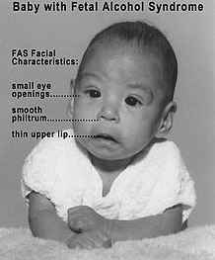
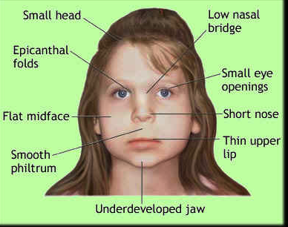
Fetal alcohol syndrome
distinctive facial features
low birth weight
behavioral &
intellectual difficulties in later life

Slide 18
General pre-conceptional advice
Body weight :
Ideal preconception BMI : 18.5-24.9 kg/m²⁼
Women who are underweight (BMI <18.5kg/m² )
difficult to conceive due to anovulatory cycles.
risk of osteoporosis and nutritional deficiencies.
increased chance of intrauterine growth restriction
low birthweight babies
should be assessed for eating disorders

Slide 19
General pre-conceptional advice
Body weight :
Overweight (BMI 25-29.9 kg/m² ) and obese ( BMI ≥ 30 kg/m²) women should loose weight with diet and exercise.
If morbidly obese (40kg/m²) or more will be very difficult to achieve normal BMI with diet and exercise
Weight should be reduced
Prescription of weight reduction medication in a carefully supervised manner
Advice to differ pregnancy till weight reduction is achieved
Referral to bariatric surgery for weight reduction ??

Slide 20
Risks of obesity to mother and her offspring.
Maternal risks of obesity
Subfertility
Miscarriage
Hypertensive disease
Gestational diabetes
Thromboembolism Infection
Cardiac disease
Instrumental deliveries
Caesarean section
Postpartum haemorrhage
Maternal death
Risks to fetus of maternal obesity
Neural tube defects
Large for dates
Preterm delivery
Shoulder dystocia
Increase in birthweight
Stillbirth
Risks to offspring of maternal obesity
Neonatal hypoglycaemia
Obesity as children and adults
Diabetes
Hypertension

Slide 21
Advice regarding medications
Drugs that are harmful to fetus may have an effect depending on the time of exposure
Pre-embryonic stage (0-14 days after conception) can result in miscarriage,
e.g. methotrexate, misoprostol, mifepristone, thalidomide, retinoid
First trimester: affect organogenesis resulting in congenital malformation, e.g. anti-epileptics, ACE inhibitors, warfarin
Second & third trimester: can cause growth restriction, affect neuropsychological behaviour, e.g. high dose Na valproate

Slide 22
Advice regarding medications
Drugs that can be used in pregnancy (if clinically necessary: benefits outweigh risks)
Analgesics: paracetamol, codeine
Antacids, ranitidine, omeprazole
Most antibiotics (avoid trimethoprim in first trimester and avoid nitrofurantoin at term)
Most antidepressants (some SSRIs, tricyclic antidepressants)
Antihypertensives: methyldopa, nifedipine, labetalol, doxazosin, prazosin, hydralazine
Antiemetics: cyclizine, promethazine, prochlorperazine, metoclopramide, domperidone, ondansetron
Antihistamines
Beta‐agonists
Inhaled and oral steroids
Hormones (insulin, thyroxine)
Laxatives
Low‐dose aspirin

Slide 23
Advice related to maternal age
Delaying child birth is associated with worsening reproductive outcomes
More cases of infertility
Medical comorbidities
Poor uterine contractility
Higher incidence of assisted vaginal deliveries
Higher incidence of Caesarian sections
Adverse fetal morbidity & mortality

Slide 24
Advice related to maternal age
Delaying child birth is associated with worsening fetal outcomes
Miscarriages
Low birth weight babies
At 41 weeks’ gestation, the risks of a stillbirth in a woman aged 35-39 is nearly double that of a woman in her twenties.

Slide 25
Risk of infertility and spontaneous miscarriage with age
Maternal age (years) | Fertility rate per 1000 married women | Spontaneous miscarriages
20 - 24 | 470 | 11 %
25 - 29 | 440 | 12 %
30 - 34 | 400 | 15 %
35 - 39 | 330 | 25 %
40 - 44 | 190 | 51 %
≥ 45 | 40 | 93 %

Slide 26
Risk of pregnancy – specific diseases with age
Pregnancy – related disease | Maternal age 20 – 29 years ≥ 40 years
Pre - eclampsia | 3.4 % | 5.4 %
Gestational diabetes | 1.7 % | 7 %

Slide 27
Risk of down’s syndrome (trisomy 21) with maternal age
Maternal age (years) | Risk of chromosomal abnormality | Risk of Down’s syndrome
15 – 24 | 1 in 500 | 1 in 1500
25 – 29 | 1 in 385 | 1 in 1100
35 | 1 in 178 | 1 in 350
40 | 1 in 63 | 1 in 100
45 | 1 in 18 | 1 in 25

Slide 28
Genetic counselling
Couples who had a previous chromosomal abnormalities or inherited diseases such as cystic fibrosis or a family history of a genetic disorders should be referred to genetic counseling.

Slide 29
Conditions where pregnancy is contraindicated
Pulmonary arterial hypertension (mortality approximately 25%).
Severe systemic ventricular dysfunction.
Previous peripartum cardiomyopathy with any residual impairment of left ventricular function.
Severe left heart obstruction, e.g. aortic/mitral stenosis with valve area <1 cm².
Marfan syndrome with aortic dilatation >4 cm.
Diabetes with HbA1c >10%.
Severe respiratory compromise, e.g. forced vital capacity <1 L.
Breast cancer within last 2 years.
Severe renal failure (creatinine >250 mmol/L).
Recurrent uterine scar rupture.

Slide 30
Conditions where pregnancy is contraindicated
If pregnancy is not recommended due to severe maternal or fetal risks:
use the most effective contraceptive method
discuss surrogacy and adoption if maternal life expectancy is not severely limited.

Slide 31
Pre-existing diabetes
The increased risk of congenital abnormalities
Insulin requirements increase during pregnancy.
Retinopathy may deteriorate during pregnancy.
Nephropathy may deteriorate as ACE inhibitors are stopped during pregnancy

Slide 32
Pre-existing diabetes
Women with diabetes, specially those with nephropathy and hypertension have a greatly increased risk of pre-eclampsia.
Complications are relate to the degree of maternal hyperglycemia, fetal hyperinsulinaemia

Slide 33
Pre-existing diabetes
Pre-pregnancy counselling allows for optimization of diabetic control
Women with BMI of > 27kg/m² should be advised for weight reduction
HbA1c < 6.1% is ideal (if >10% contraception should be provided till good glycaemic control is achieved)
Changing to favorable medications like insulin and metformin
Commencing 5mg of FA

Slide 34
Previous pregnancy with pre-eclampsia
Chance of recurrence is less than for a first pregnancy
Women who have had pre‐eclampsia in a previous pregnancy have a 10% chance of recurrence.
The recurrence is higher if the onset was early (<34 weeks’ gestation),
To discuss the possible long hospital stay, preterm delivery
Pre pregnancy Ca ++ supplementation, for women with low dietary intake and low exposure to sunlight
Administration of low‐dose aspirin from early pregnancy is associated with reduced risks of developing pre‐eclampsia
Aspirin from 12 weeks of pregnancy

Slide 35
Pre-pregnancy management of epilepsy
Consider referral for specialist opinion before conception to reduce or change drug treatment if possible.
Counsel about the balance between the possible harm done by medication compared with that done by seizures (to both mother and fetus).
Recommend folic acid 5 mg per day before conception and up to 12 weeks following conception

Slide 36
Pre-pregnancy management of epilepsy
Most anti-epileptic drugs (AEDs) are teratogenic
Fetal malformations (most commonly neural tube defects, cleft lip / palate and cardiac malformations) occur in 4% of those diagnosed with epilepsy but not taking medication
Increase to 6% when taking medication (polytherapy with certain drugs can have a much higher risk).

Slide 37
Pre-pregnancy management of epilepsy
Women who are seizure free for more than two years may discontinue AED after neurologists opinion.
Control of epilepsy should be prior to pregnancy with lowest dose of most effective treatment.
Polytherapy should be avoided if possible.

Slide 38
Thyroid diseases
Effect of pregnancy on thyrotoxicosis
Hyperthyroidism ? ? ? ?
Effect of thyrotoxicosis on pregnancy
? ? ? ?
Effect of pregnancy on hypothyroidism
Hypothyroidism ? ? ? ?
Effect of hypothyroidism on pregnancy
? ? ? ?

Slide 39
Summary
Pre-pregnancy assessment will help to identify risk factors related to general health and previous pregnancies.
Pre-pregnancy counselling help to optimize the health status of women going into pregnancy
Higher folic acid doses are needed in specific situation
Optimizing BMI will help in improving outcome

Slide 40
Thank you !!

